Slide 1
AI Platform
MVP Considerations – AgentCore – Initial Perspectives
October 7, 2025.
Dermot O’Brien | Architecture Colleague & Data | Technology Strategy and Architecture
PRELIMINARY
AI Assisted
CURATED

Slide 2
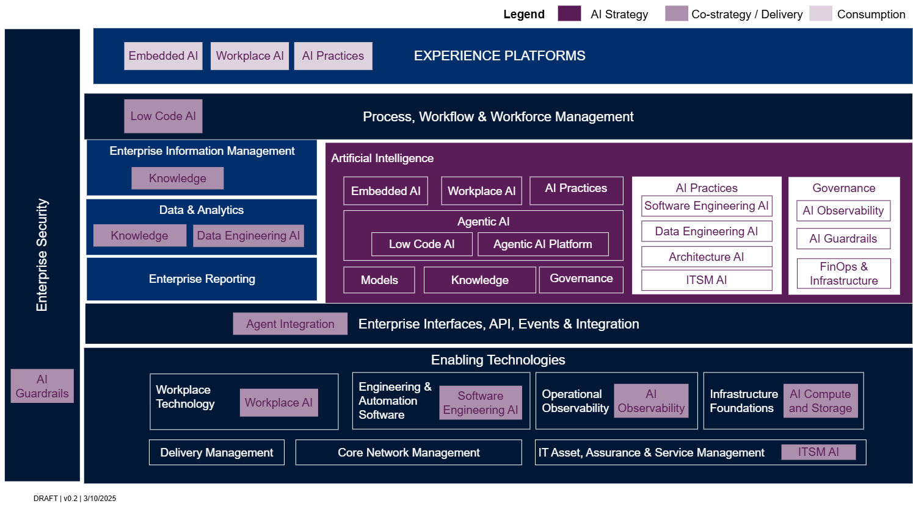
We continue to make good progress on the definition of our AI Platform target state architecture
AI Platform capabilities
An AI Platform target state architecture (TSA) blueprint has been published for initial alignment.
Relating to MVP

Slide 3
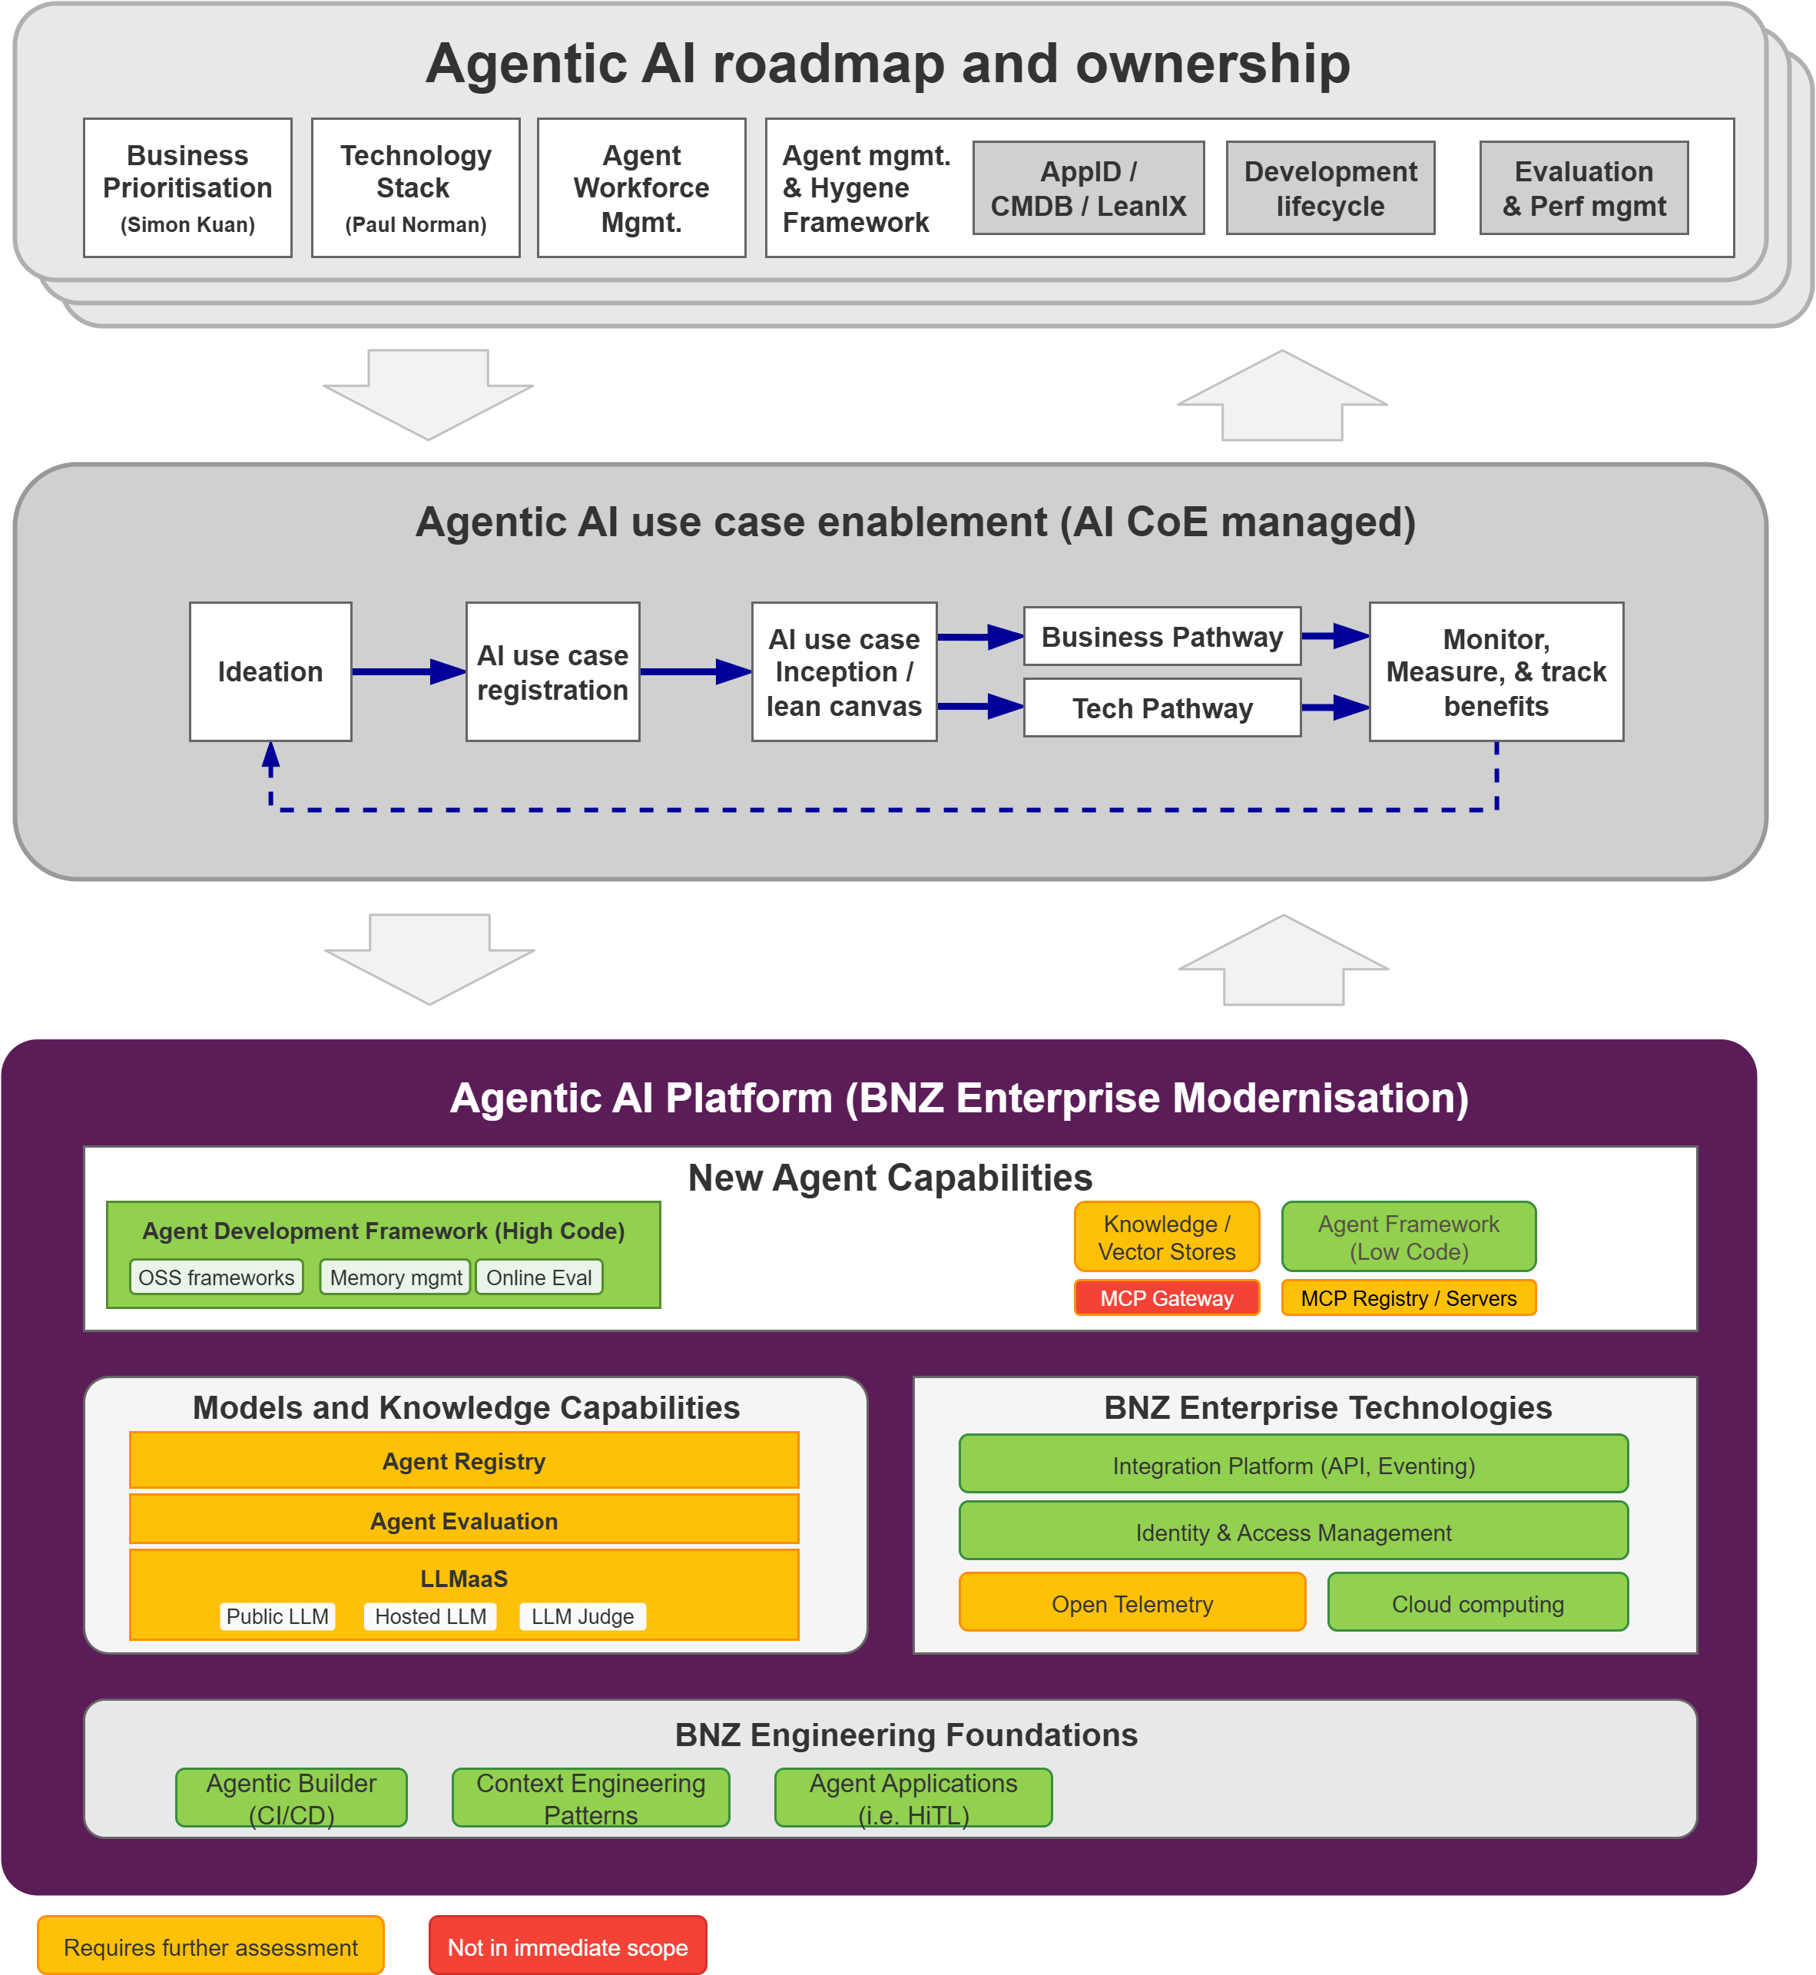
We can proceed with an agentic AI MVP that leverages NAB research but aligned to our platforms
AI Platform capabilities
Capabilities | Requirements | MVP Decisions | Post MVP | Capability Area | Capability
Agent Development framework | Define how agents are designed, how they interact, and how they achieve their objectives. | Strands LangGraph |  | Agentic AI | AG2. Agent Development Frameworks
Agentic hosting / runtime | Auto-scaling runtimes, scheduler systems, and queue systems for agent execution with Network-level security including private networks and traffic isolation. | AWS AgentCore Runtime | Kubernetes Containers | Agentic AI | AG1.1 Runtime Environment
Agentic builder (CI/CD) | Code integration, testing, and deployment. | BNZ tooling |  | Agentic AI | AG2.4 Development Tools
Graph Database (Semantic) / Vector (traditional RAG) | Interconnected web of facts that illustrates the semantic relationships between entities. | Neo4j community? / MongoDB for vector? | Neo4 enterprise? | Knowledge | KN3. Knowledge Storage
Context Memory and State management | Context management, long-term memory systems, and knowledge stores. | PostgreSQL | Mem0 | Agentic AI | AG1.5 Memory Services
Agent Registry | Metadata about each agent, allowing other agents or systems to discover and interact with them. | TBD | Build our own? / NAB Follow? | Agentic AI | AG7. Agent Segmentation
MCP Gateway | Aggregating multiple MCP servers behind a single. | Secure interface. | TBD | Agentic AI | AG2 Agentic AI
MCP Registry / Servers | Responsible for executing AI logic, handling tool execution, and managing session context between Agents and platform services. | Use case specific e.g. GitHub, Data Products, ServiceNow | MCP Registry (recent launch from Anthropic) | Agentic AI | AG3.4 Action and Tool Use
Agent evaluation & observability | Specialised monitoring for agent performance, evaluation logs, conversation quality, and behavioural analytics for business and technical owners. | TBD / Open Telemetry | Inhouse build / NAB follow? | Agentic AI | AG3.5 Monitoring and Observability
Large Language Model serving (LLMaaS) | Core language models that power agent reasoning and natural language understanding. | AWS Bedrock | AWS Bedrock | Models | ML1
Agent Intent and Eventing | Decoupling A2A and enabling asynchronous communication with durable messaging. | BNZ Eventing | BNZ Eventing | Agentic AI | AG5.3 Agent-to-Agent

Slide 4
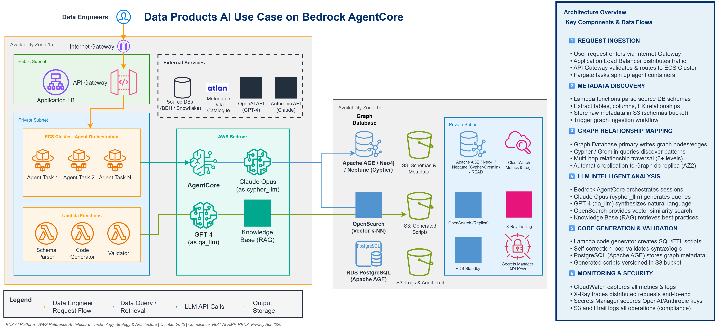
e.g. Data products could be done on this Bedrock / AgentCore based MVP platform
Leveraging Bedrock AgentCore supported agentic frameworks.
Indicative

Slide 5
AI Target State
Appendix A
See
AI Platform - Target State Architecture - Working

